Slide 1
Binary Prefix Search
Author: Yeim-Kuan Chang
Publisher/Conference: COMPUTER NETWORKS
Presenter: Chun-Yu, Li
Date: 2016/07/13
Department of Computer Science and Information Engineering
National Cheng Kung University, Taiwan R.O.C.
Notes:
1

Slide 2
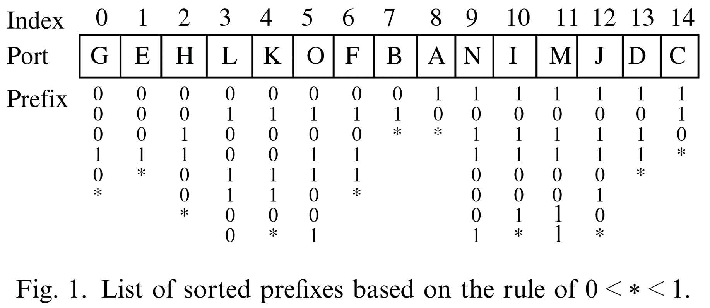
Introduction
We sort the prefixes, and use binary search to find out which prefix matches the input IP address.
Definition 1 : 0 < * < 1 is used to compare two prefixes in ternary format.

Slide 3

Binary Prefix Search
Directly performing a binary search on the list of sorted prefixes may encounter a failure: Dst = 01011000
2
4
3
1
Correct match
Failed match

Slide 4
Binary Prefix Search
Enclosure relationship between prefixes results in the search failure
Generate some auxiliary prefixes that inherit the routing information of the original LPM (e.g., F) and put them where the binary search operations can find them.
ex. auxiliary prefix 01011000.
Therefore, it is feasible to split prefix F into two parts such that both sides of prefix O are covered.

Slide 5
Binary Prefix Search
The full tree expansion
The full tree expansion splits the enclosure prefixes into many longer prefixes (leaf pushing).
Auxiliary prefix merges
Many auxiliary prefixes may inherit the same routing information of a common enclosure prefix. These prefixes can be merged into one. The merge operation is defined as follows.
Definition 2 (Prefix merge):
The prefix obtained by merging a set of consecutive prefixes is the longest common ancestor (LCA) of these consecutive prefixes in the binary trie

Slide 6
Binary Prefix Search
LCA (Longest Common Ancestor)
LCA(00001,001**)=00***

Slide 7
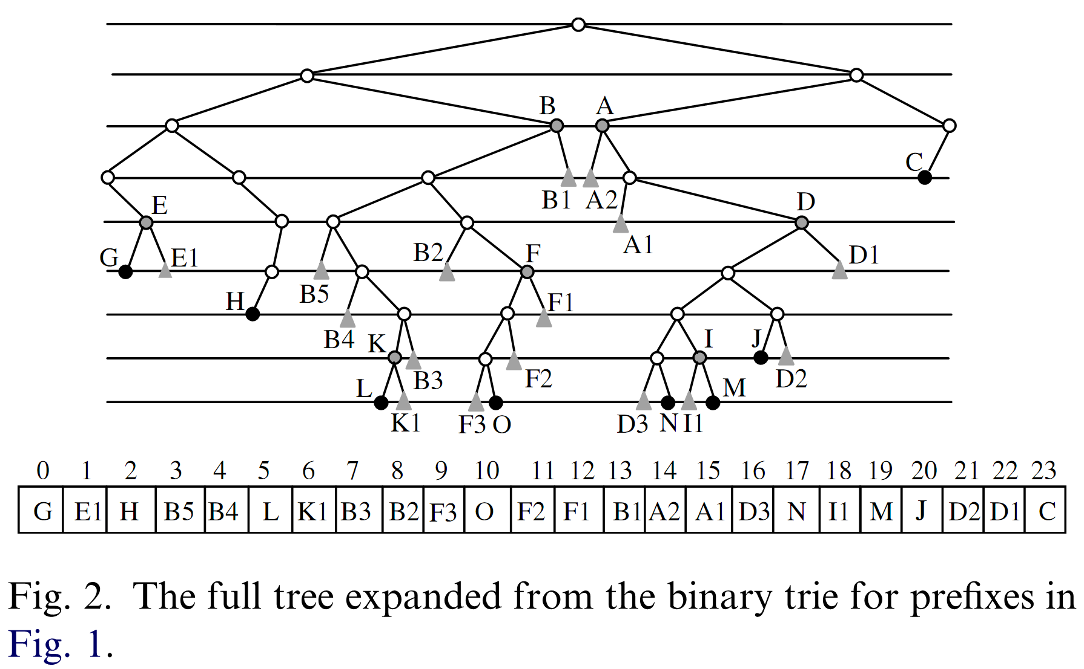
Binary Prefix Search
The full tree expansion
F3=01011000

Slide 8
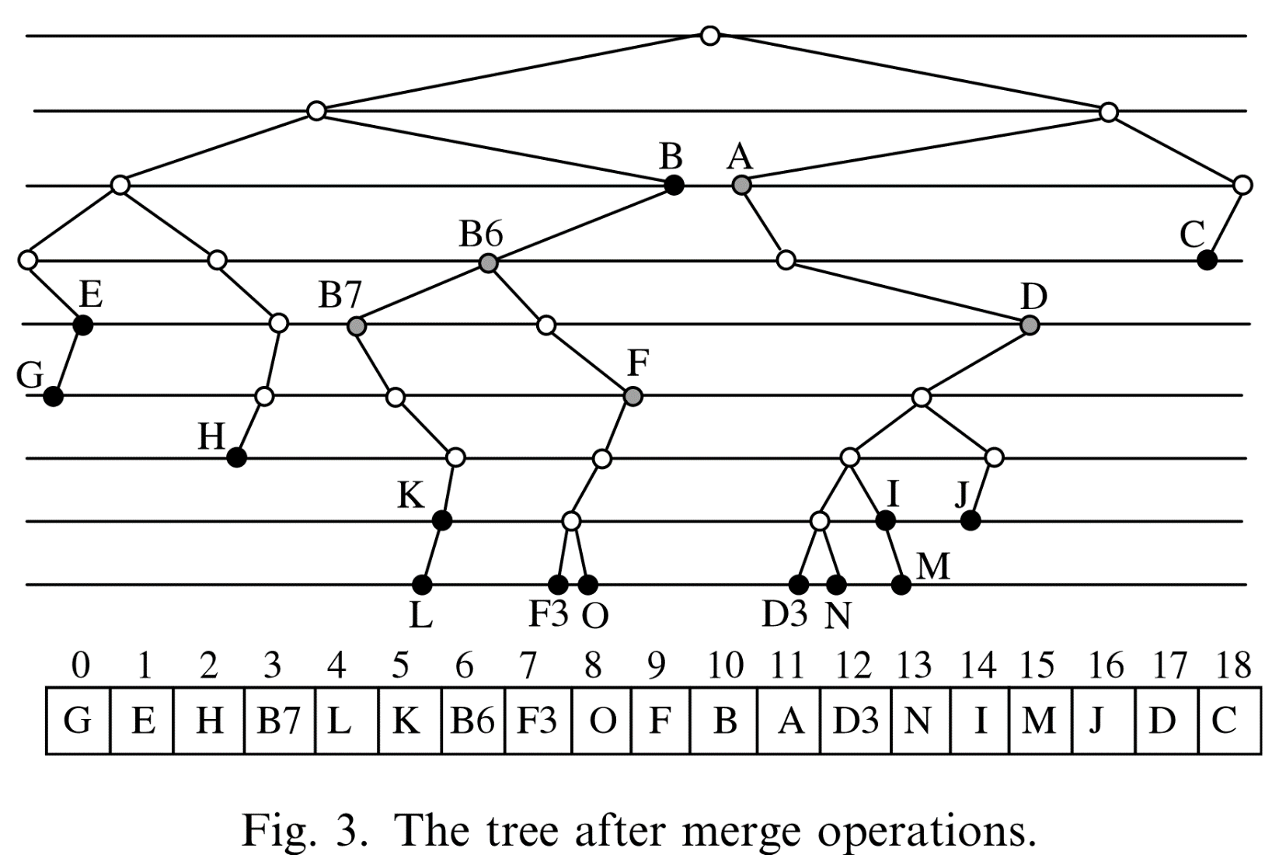
Binary Prefix Search
The full tree after the merge operations

Slide 9
(n+1)-bit Prefix Representation
For efficient comparisons between prefixes
(n+1)-bit representation for n-bit prefix.
b_{n–1}…b_{n–i}*…* → b_{n–1}…b_{n–i}10…0
with n – i trailing zeros.
Example: 01* and 01010* in an 8-bit address space From Deﬁnition 1, we have 01* > 01010*, by (n+1)-bit representation, we represent 01* and 01010* as 011000000 and 010101000, respectively.

Slide 10
n-bit Prefix Representation
Consider two preﬁxes P1 = 01001100/port1 and P2 = 01001*/port2. The 9-bit preﬁx representations of P1 and P2 are 010011001 and 010011000, respectively.
In general, when two preﬁxes have the same ﬁrst 8 bits, one of them must be of length 8, and the other may be of any length except 8.
We call one of these two pre-ﬁxes as the buddy preﬁx of the other.
We solve this problem by means of the following rule: only the preﬁx of length n-1 is allowed to have a buddy preﬁx of length n coexisting in n-bit address space.
Notes:
In order to make the binary search on the sorted list of
8-bit preﬁxes correct, every time a preﬁx is matched
against the target IP, we need to do a further check
if its buddy preﬁx also exists on its left or right side.
This additional check signiﬁcantly slows down the
search process.

Slide 11
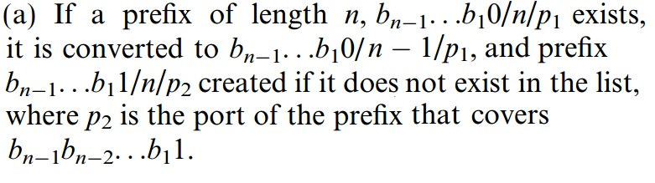
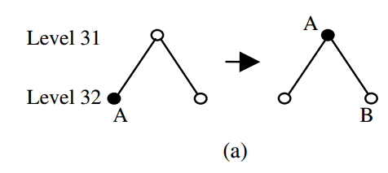
n-bit Prefix Representation

Slide 12
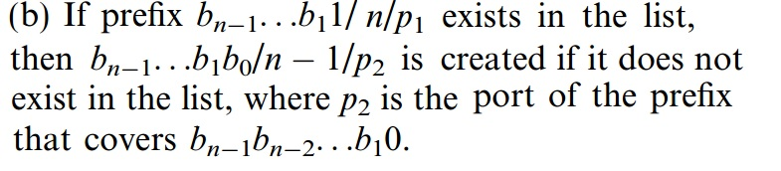
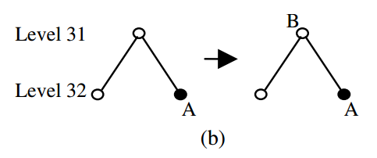
n-bit Prefix Representation

Slide 13

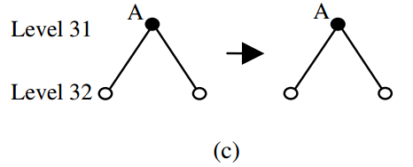
n-bit Prefix Representation

Slide 14

n-bit Prefix Representation

Slide 15
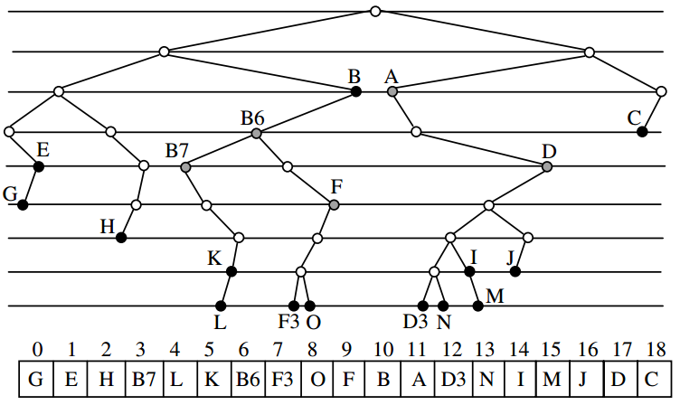
n-bit Prefix Representation

Slide 16
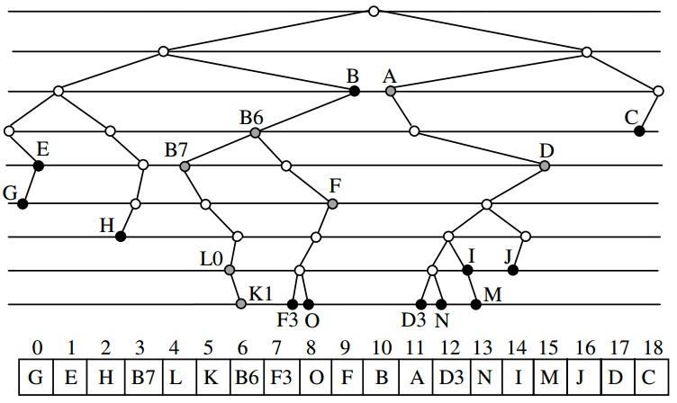
n-bit Prefix Representation

Slide 17
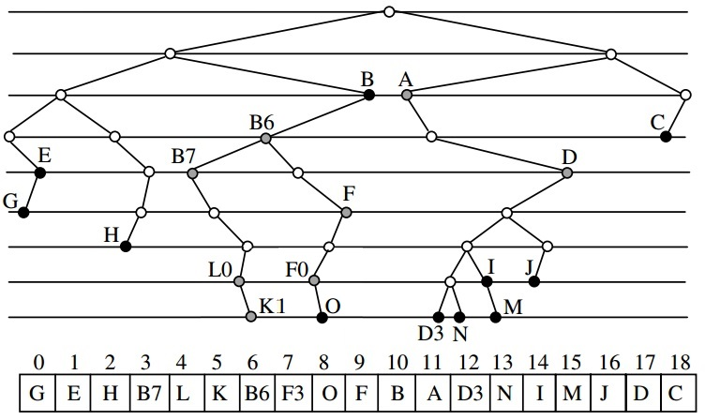
n-bit Prefix Representation

Slide 18
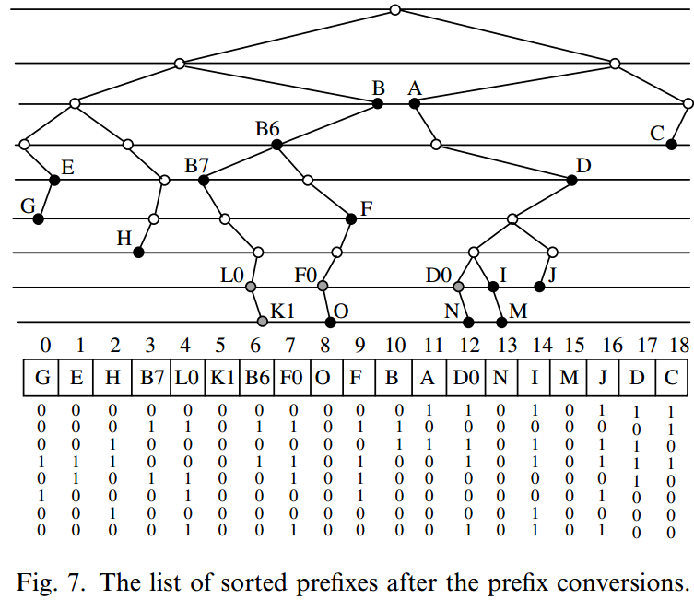
n-bit Prefix Representation

Slide 19
Binary Prefix Search

